Slide 1



miRNA therapy for CRC:
BACTERIAL PRODUCTION AND DELIVERY
iGEM Club, IITD
2024
1

Slide 2



Colorectal Cancer(CRC)
01
Prevalence
CRC is the third most commonly diagnosed cancer worldwide, with over 1.9 million new cases and nearly 935,000 deaths reported in 2020. According to the Indian Council of Medical Research (ICMR), the incidence of CRC in India is projected to increase by 128% in men and 125% in women by the year 2030.
02
Challenges in diagnostics
The National Cancer Registry Program of India reported that nearly 57% of CRC cases in India are diagnosed at an advanced stage, leading to poorer outcomes. Limited awareness, inadequate screening programs, and uneven distribution of healthcare facilities are reasons behind this low diagnosis rate.
3

Slide 3
Existing Therapies
01
Major modalities of treatment
Existing therapies for CRC include surgery, chemotherapy, radiation therapy, targeted therapy, and immunotherapy. While these treatments have shown effectiveness in managing CRC, they also have various disadvantages.
02
Disadvantages of major modalities
Surgery, the primary treatment for localized CRC, can lead to complications such as infections, bleeding, and damage to surrounding organs.
Chemotherapy, often used in combination with surgery, can cause side effects like nausea, hair loss, and fatigue.
Radiation therapy, while effective in treating specific cases of CRC, can damage healthy tissues surrounding the tumour site.
Targeted therapy and immunotherapy have shown promising results in some CRC patients, but not all patients respond to these treatments, and they can be costly and have long-term side effects.
4

Slide 4

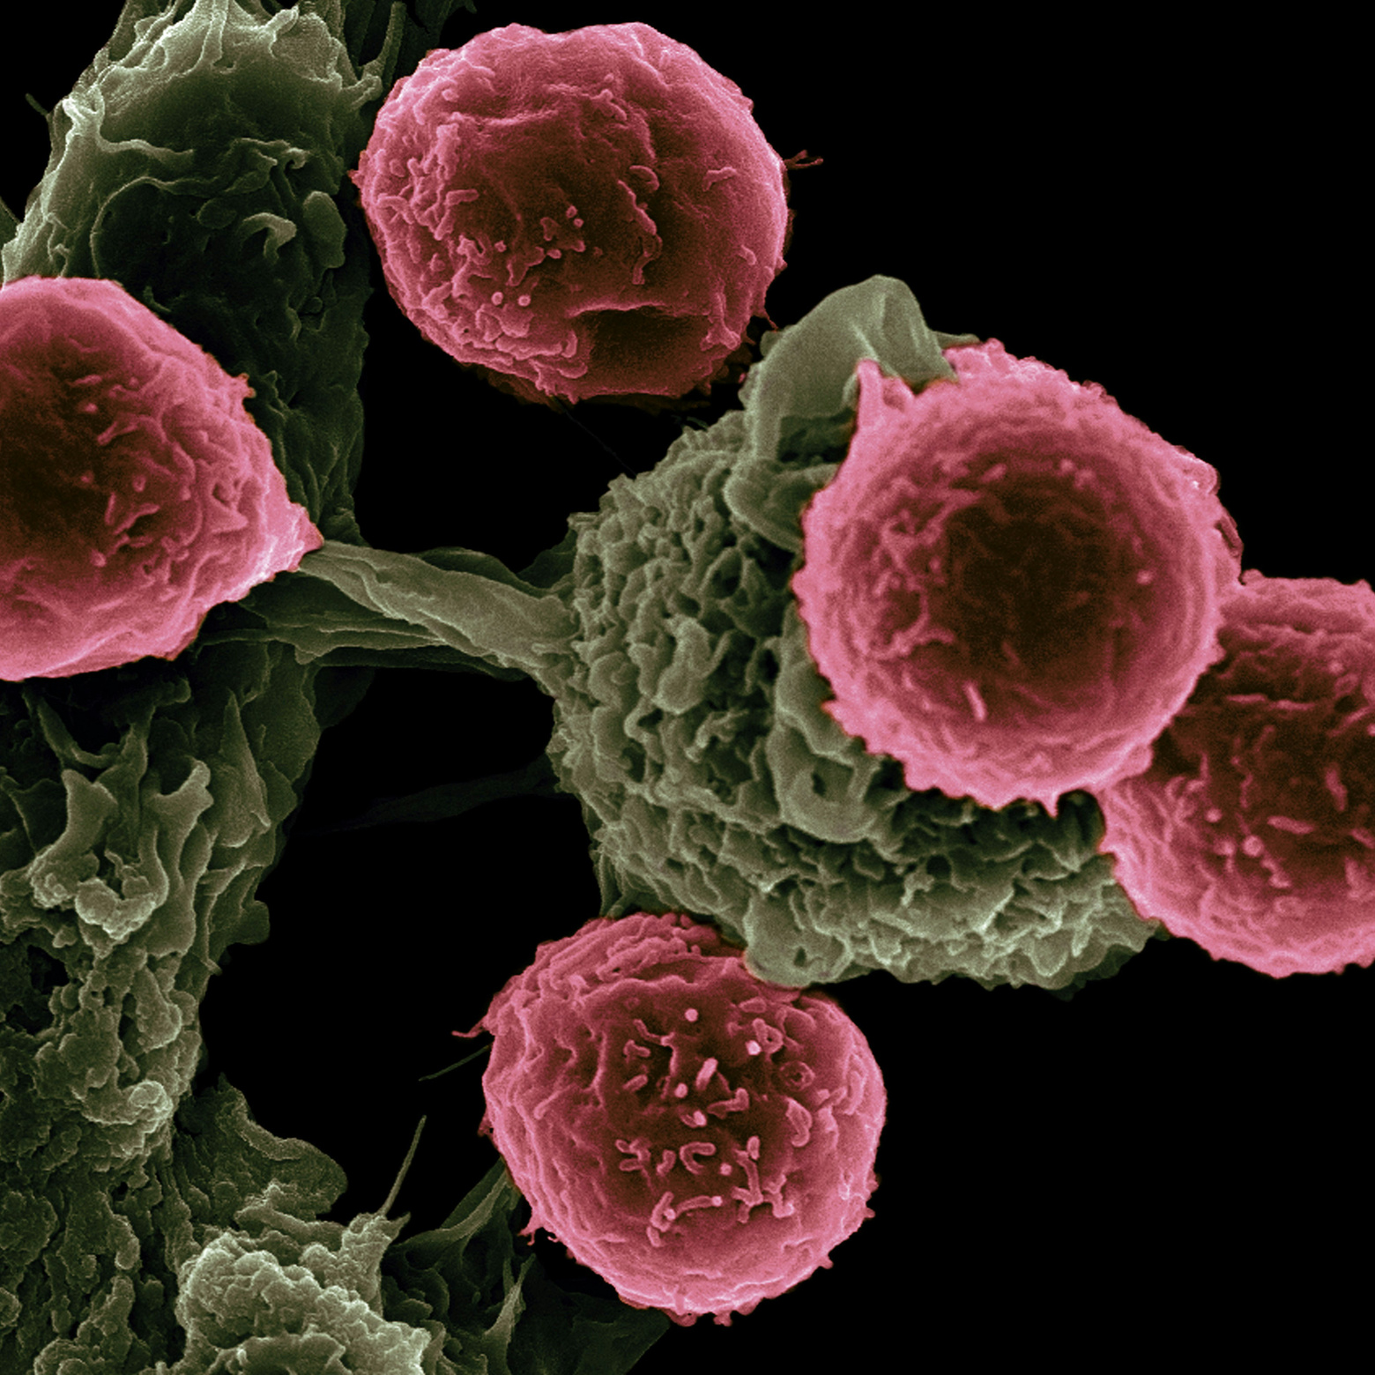
Why Gene Therapy?
FUTURE OF CANCER TREATMENT
Gene therapy holds great promise for revolutionizing the treatment of CRC by addressing the limitations of existing therapies and offering targeted and personalized treatment strategies.
5

Slide 5
Gene
Therapy
01
Advantage of gene therapy
One of the significant advantages of gene therapy is its potential for targeted treatment, where therapeutic genes are delivered directly to cancer cells, minimizing damage to healthy tissues. Gene therapy can also be tailored to individual patients based on their genetic makeup and tumor characteristics, leading to personalized treatment strategies.
02
Gene Therapy modalities
Some existing delivery methods include viral vectors, non-viral vectors, and RNA-based therapies.
Viral vectors face the issue of limited capacity for large genes and they might trigger immune responses.
Non-viral vectors, like liposomes and nanoparticles, offer the advantage of reduced immunogenicity and toxicity, but they face issues in transfection efficiency and stability.
03
Using RNAi for gene therapy
RNA-based therapies, such as small interfering RNAs (siRNAs) and messenger RNAs (mRNAs), have emerged as promising tools for gene therapy in CRC.
6

Slide 6


Our Solution
E. coli Nissle 1917 as Producer and Carrier of miRNA to the Cancer Cells
7

Slide 7



Part 1
Project Description

Slide 8
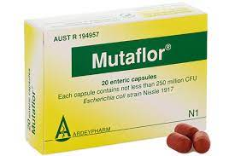

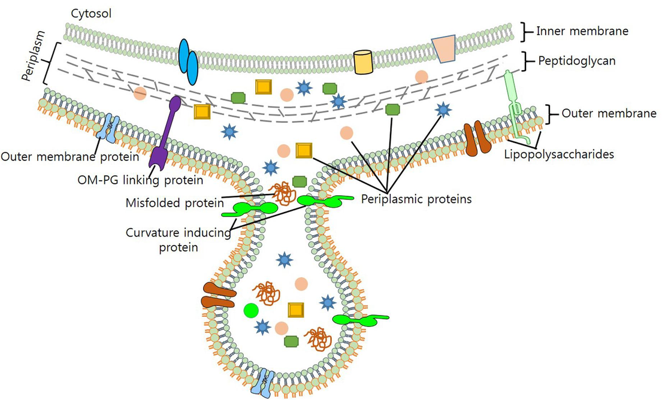
Why E. coli Nissle? What is OMV?
EcN is a Probiotic Bacteria, already a part of Gut Microbiome
It is a GRAS (Generally Regarded As Safe) Strain of E. coli.
OMVs or Outer Membrane Vesicles are nanoscale spherical vesicles released from Gram-negative bacteria.
These can be engineered to display specific targeting Affibodies.
It is prevalently used as a mode of drug delivery
8

Slide 9
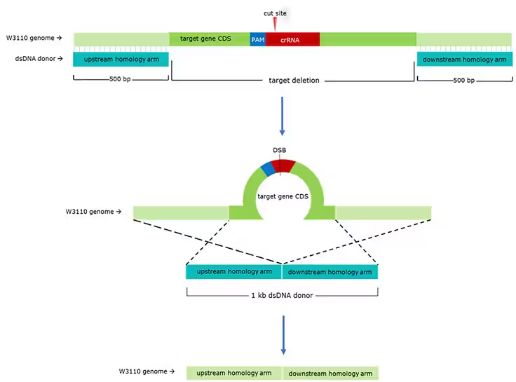
Development of Novel Chassis for in vivo OMV overproduction
tolA K/O
miRNA
Many Bacteria natively produce OMVs (which includes EcN). But for drug delivery, we require a larger number of it.
tolA gene K/O in E. coli have been shown to increase the OMV
production in E. coli (especially K-12)
For this we need to construct the sgRNA containing plasmid and the Cas9 Plasmid.
Substituting the gene with lambda-Red is quite prevalent as a Reporter sequence.
Recombinant RBP
Surface Nanobodies
Cre-Lox Gene Regulation
9

Slide 10
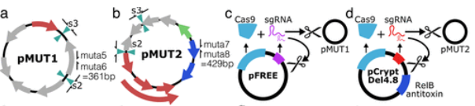
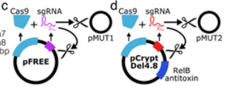
Development of Novel Chassis for in vivo OMV overproduction
tolA K/O
miRNA
Also, EcN has pMUT1 and pMUT2 plasmids constitutively.
So, before proceeding we would need to cure the EcN of plasmids.
CRISPR-Cas9 based Curing:-
2 Plasmids Required
pFREE
pCryptDel4.8
Recombinant RBP
Surface Nanobodies
Cre-Lox Gene Regulation
10

Slide 11
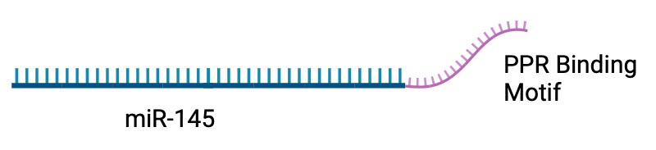
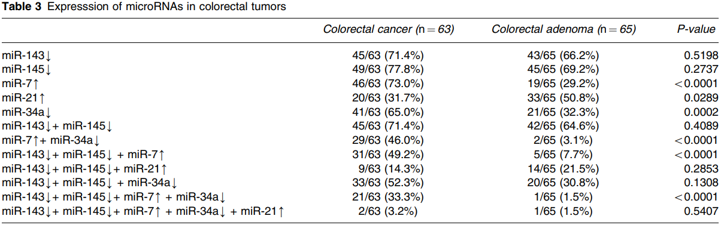
miRNA for Therapy of CRC
There are many miRs in CRC cells which are over and under expressed. As our model would be most suitable for delivery of miRs to the Cancer cells, we would be targeting the down-regulated miRs, specifically miR-145.
Length of miR-145 gene :- 1 . 8 kB
And also a short RBP homing sequence needs to be added (Length can be decided after further discussion)
miRNA
Recombinant RBP
Surface Nanobodies
Cre-Lox Gene Regulation
11

Slide 12
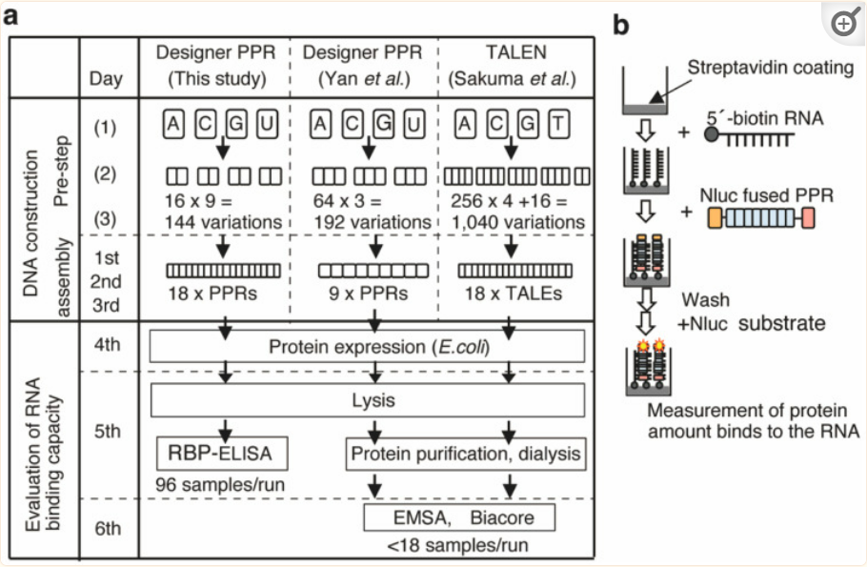
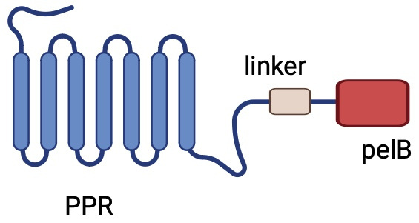
Recombinant RBP
Multiple RNA Binding Proteins are present in E. coli. PPR is one of them. (It is a homo-multimer).
PPR is highly versatile for Engineering Binding Specificity to a particular RNA sequence.
Each subunit can be engineered to be specific to particular Nucleotide of RNA.
Subunits seamlessly joined to each other by Golden Gate Assembly.
Recombinant RBP
Surface Nanobodies
Cre-Lox Gene Regulation
12

Slide 13
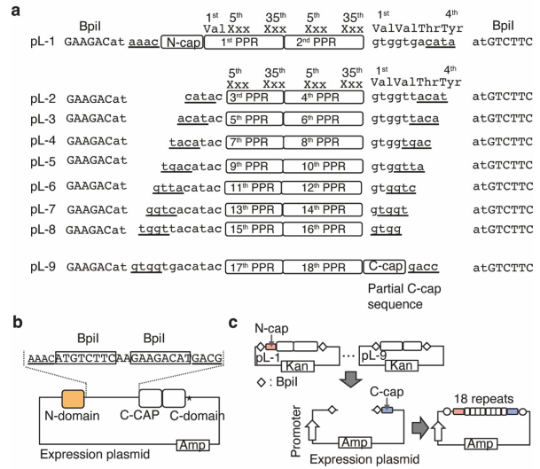
Recombinant RBP
Here is a brief description on how we are planning on achieving the assembly.
At the end of RBD, a pelB sequence also needs to be added.
PelB is a signalling peptide
Carries attached proteins to the Periplasmic Space
Length of PelB :- 22 Residues
Length of one subunit of PPR :- 35 Residues
Recombinant RBP
Surface Nanobodies
PelB :- MKYLLPTAAAGLLLLAAQPAMA
PPR2.0_A (for adenine): VVTYTTLIDGLCKAGDVDEALELFKEMRSKGVKPN
PPR2.0_C (for cytosine): VVTYNTLIDGLCKSGKIEEALKLFKEMEEKGITPS
PPR2.0_G (for guanine): VVTYTTLIDGLCKAGKVDEALELFDEMKERGIKPD
PPR2.0_U (for uracil): VVTYNTLIDGLCKAGRLDEAEELLEEMEEKGIKPD
Cre-Lox Gene Regulation
13

Slide 14
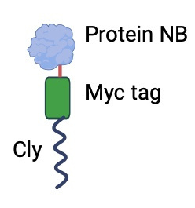
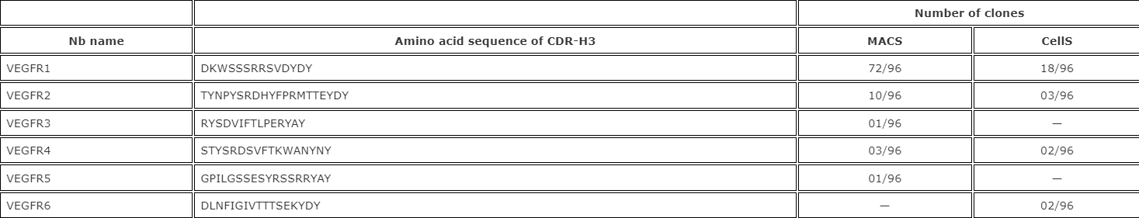
Surface Expression of Affinity Nanobodies
For increasing the specificity of OMV-based therapy, we need to add some surface receptors for target Cell Surface Antigens.
Overexpression of EGFR is prominent for CRC cells.
Nanobodies have been created having high binding affinity towards EGFRs. Particularly, VEGFR1 is shown to have a high efficacy.
Fusion Protein needs to be created of Nb with Cly-Protein (a surface Protein of E. coli) and a Myc Tag for easier Western blot.
Surface Nanobodies
Cre-Lox Gene Regulation
14

Slide 15
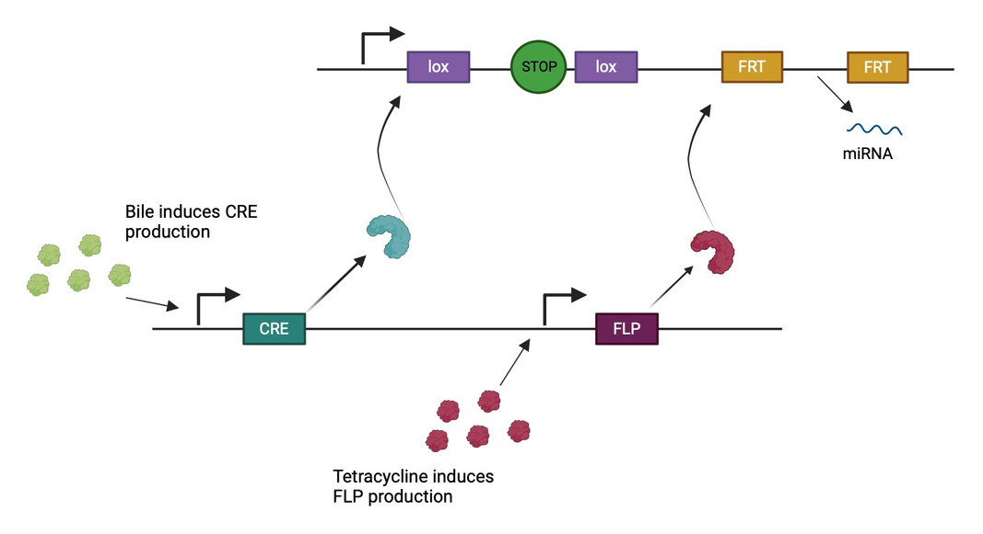
Recombinase switches for regulation via in-vivo knockout
One time knockouts of two separate sequences
One to kickstart miRNA production and other to irreversibly stop it
Bile inside gut will start constitutive expression (when the bacteria is first planted in human gut) by excising stop signal
Tet (at the end of therapy/cancer cured) will knockout the RNA gene to prevent metabolic burden .
Cre-Lox Gene Regulation
15

Slide 16

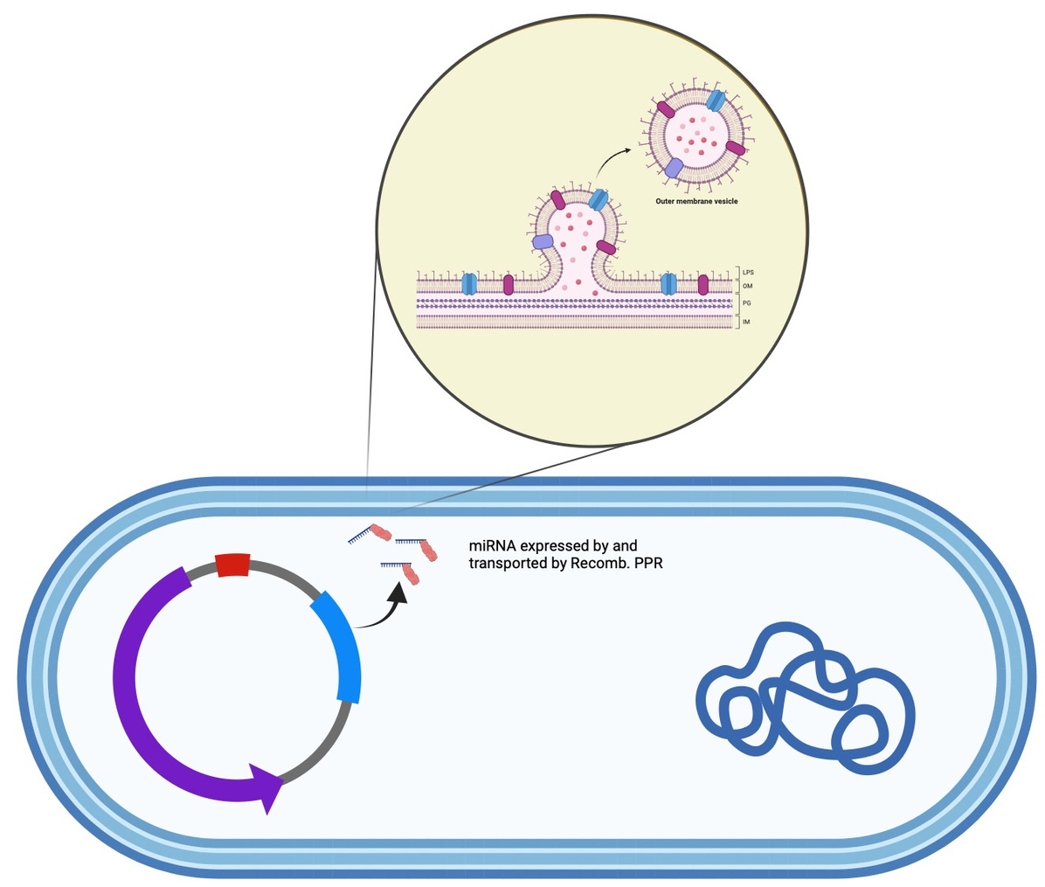
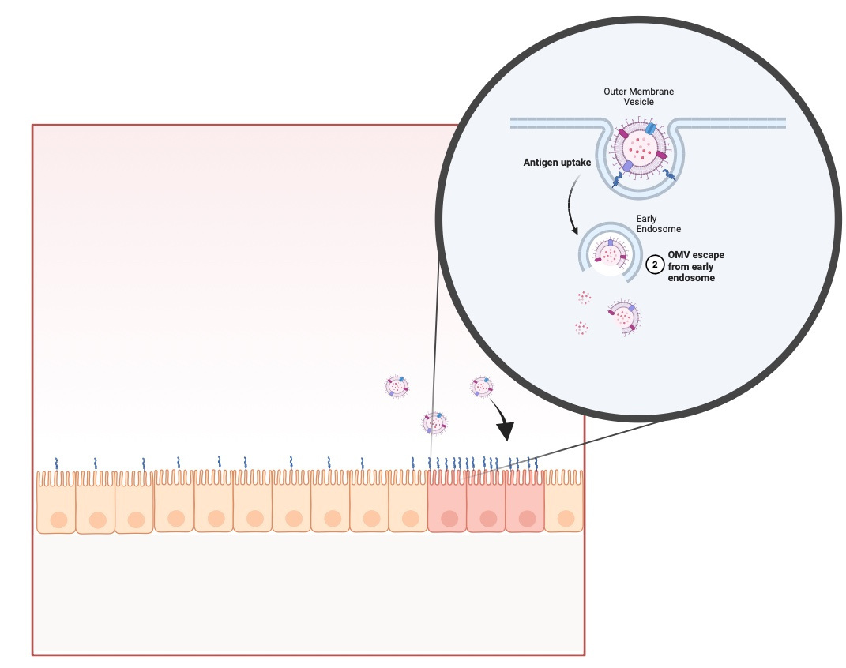

Slide 17
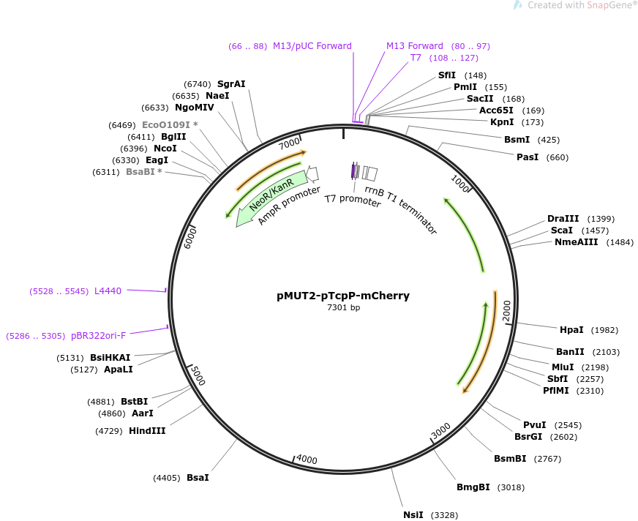
Expression Vectors
Expression Vectors :- pMUT1 and pMUT2
Because already present in EcN and is also a Cryptic Plasmid
Cryptic Plasmids are Antibiotic-Resistance-Free Plasmids, usually used for Probiotic purposes.
Also EcN retains pMUT1 and pMUT2 upto 90 generations without any external pressure
Cloning in pMUT2-pTcpP-mCherry :-
It has a bile inducible promoter, which we can use to induce the production of Cre Protein.
16

Slide 18
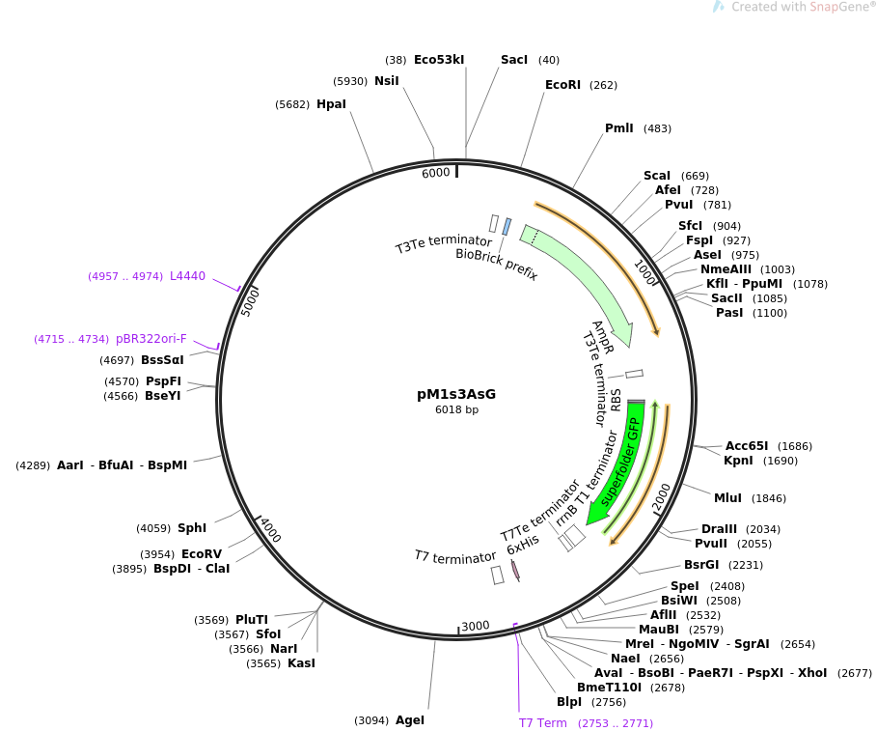
Expression Vectors
Expression Vectors :- pMUT1 and pMUT2
Because already present in EcN and is also a Cryptic Plasmid
Cryptic Plasmids are Antibiotic-Resistance-Free Plasmids, usually used for Probiotic purposes.
Also EcN retains pMUT1 and pMUT2 upto 90 generations without any external pressure
Cloning of pM1s3AsG :-
2 clones :-
Recombinant PPR
Surface Nanobodies
17
20

Slide 19
OBJECTIVE | DESCRIPTION | TEST FOR POC | TIMELINE
Development of Novel Chassis for in vivo OMV Production (in EcN) | Knockout of tolA gene for OMV overproduction; Curing of pMUT1 and pMUT from EcN. | lambda-Red based Detection of K/O SDS-PAGE and Western Blot for OMV Overproduction Detection FISH for detection of oriC of Plasmids. | K/O:- Mid-April to Majors; Majors to Late-May Curing:- Late-May to Late June
Recombinant RBP (in K-12) | PPR protein design for specific RNA sequence. | Flouroscent tag detection 2. EMSA for detecting the binding of Protein to RNA | Simulation:- Early April to Majors Cloning and Testing:- Late May to late June
Surface Expression of Affinity Nanobodies (in K-12) | Fusing EGFR specific Protein Nanobody with Cly-Protein | Western Blot of Myc Tag present in the fusion protein | Fusion Protein Gene Making:- Early April to Major Cloning and Testing :- Late June to mid July
Recombinase switches for regulation via in-vivo knockout (in K-12) | Cre-Lox based System for Inducible Constitutive Production of miR 145 | Checking the miRNA production when induced by Bile. | Design of Complex :- Late May Cloning and Testing :- June to late July
Computational Methods to be implemented | PPR-RNA binding Molecular Dynamics Kinetics modelling of Molecule Production Microbiome Interaction Dynamics Simulation Dosage Simulation | - | Early April to Late July
18

Slide 20
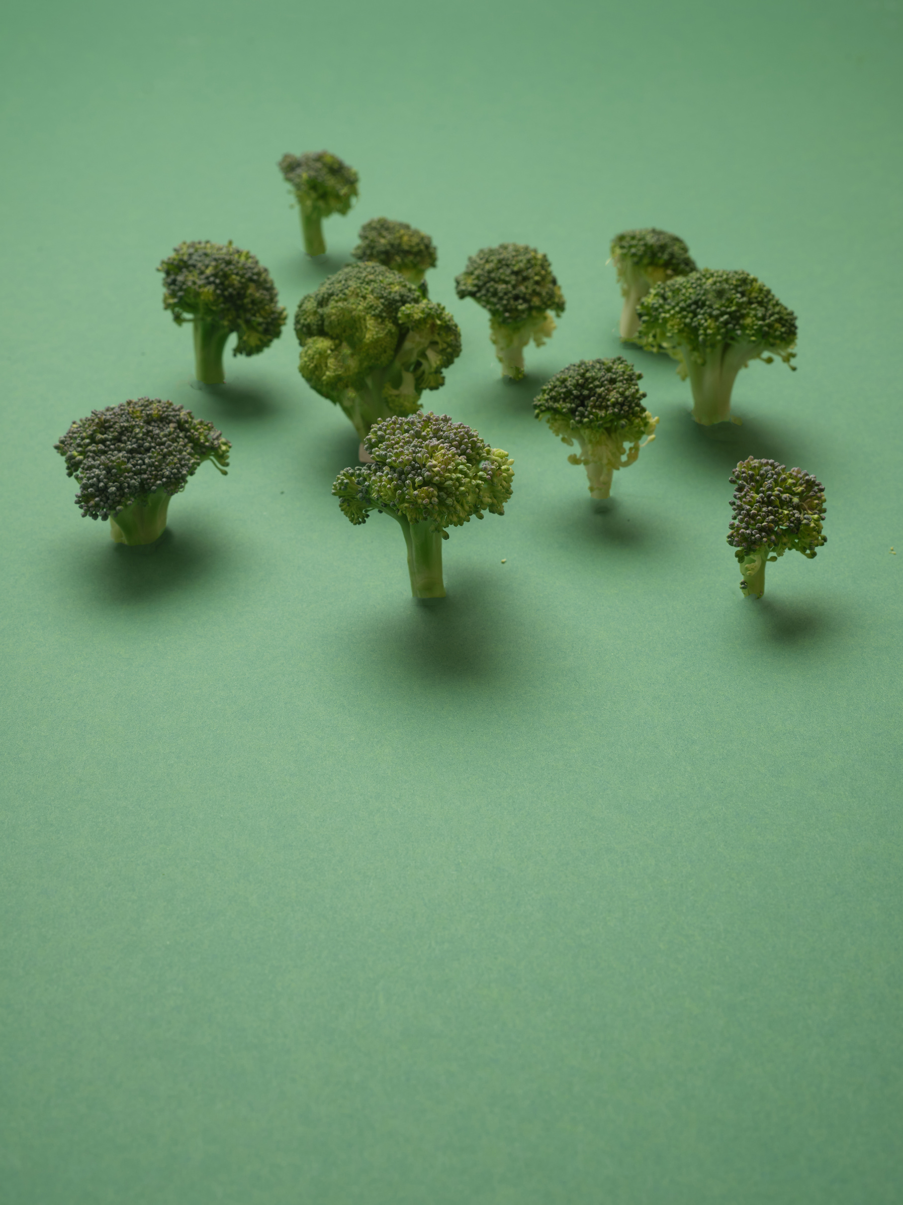

Part 2
Timelines and Funds for the Project Progress

Slide 21
CONSUMABLES | SOURCE | COST
Plasmids(pFREE, pCryptDel4.8, pMUT2pTcpP-mCherry, pM1s3AsG) | Addgene: pFREE: https://www.addgene.org/92050/ pCryptDel4.8: https://www.addgene.org/141293/ pMUT2pTcpP-mCherry: https://www.addgene.org/192861/ pM1s3AsG: https://www.addgene.org/137921/ | 1000 USD
Lab Consumables(Enzymes, Petri dishes, Broths, primers, etc.) |  | 4500 USD
Antibodies for OMVs, Anti-Myc and POC Experiments | Sigma Aldrich | 2000 USD
Synthesized Genes | IDT (sponsor of iGEM)
19

Slide 22
iGEM TIMELINE
RESPONSIBILITY | TIMELINE | STUDENTS RESPONSIBLE | REQUIREMENTS
EC MEETING | MARCH 22 | PRATHAM, TUHIN, AJAI | -
TEAM REGISTRATION | APRIL 05 | SHASHANK, PRATHAM, VIDYA | 6000 USD
IMPACT GRANT | MAY-JUNE | SHASHANK, VIDYA | -
JAMBOREE REGISTRATION | JULY-AUGUST END | SHASHANK, PRATHAM | 3000 USD
SAFETY FORM | PRELIMS-5 JUNE FINAL-4 SEP | KUSHAGRA | -
PROMOTIONAL VIDEO | 4 SEP | PRATHAM | -
TEAM ROOSTER | 11 SEP | TUHIN | -
WIKI | 2 OCT | PARTH, KUSHAGRA, RAVINDER | -
20

Slide 23
Vertical Distribution
VERTICAL | STUDENTS RESPONSIBLE
WET LAB | AMOGH, TUHIN, PRATHAM
DRY LAB | PARTH, KUSHAGRA
HP/EDUCATION | VIDYA, PRATHAM, PARTH
DESIGN/WIKI/WEBSITE | RAVINDER, KUSHAGRA
FUNDRAISING | SHASHANK, PRATHAM, VIDYA
21

Slide 24



Thank you
Instructors
Prof. Ritu Kulshrestha
Prof. Vivekanandan Perumal
Students
Amogh Varshney
Tuhin Kumar Raut
Prathamdeep Dhanoa
Shashank Choudhary
Parth Patel
Kushagra Patel
Ravinder Kuhad
Vidyadarshini R.

